Slide 1
Welcome to Section
Week 6
Introduction to Data Structures

Slide 2
01
02
Agenda
Check-in
Recap
How are you doing?
Going over lists and dictionaries again
03
04
05
Index Game
List Practice
Heads Up
Refreshing list indexing!
Get practice creating and modifying lists!
Get practice functionally utilizing lists!

Slide 3
Check-in
Unfortunately, it is the end of Code in Place. Let’s reminisce a bit, shall we? What was your favorite problem, section, or memory from your time here? I’ll go first!

Slide 4
Questions?

Slide 5
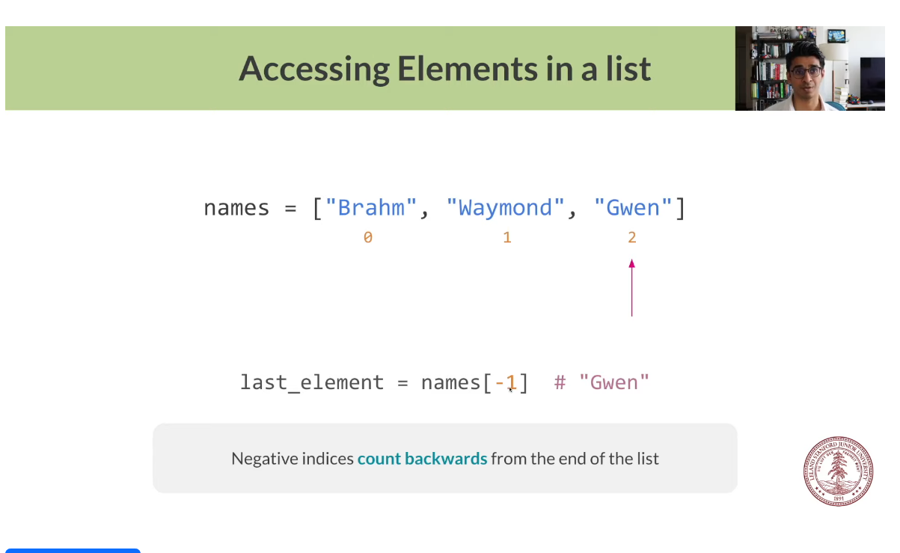
Recap

Slide 6
Data Structures
List
Dictionary
An ordered collection of values. Usually used to store a “list” of similar data. One example might be an attendance roster. It’s usually in order alphabetically (but it doesn’t have to be) and stores a list of names!
An unordered collection of key/value pairs. Usually used to store relational data. One example is a phone book or a contact list in a phone. Each name has a number associated with it!

Slide 7
Lists
Some useful documentation:
list_name = []
list_name = [value_1, value_2, ..., value_n]
list_name.append(elem)
list_name.insert(index, elem)
list_name.remove(elem)
popped_item = list_name.pop(index)
accessed_item = list_name[index]

Slide 8
Lists
Some basic reminders regarding lists:
Lists are ordered, meaning you can access items (often called elements) using their index (what spot they are) in the list.
Indexing starts at 0 in Python! This means that the very first element in a list has index 0.
Lists are mutable, if you make changes to a list in a helper function, they actually modify the list!
Lists don’t need to contain data of the same type. It is just more common.
This means that a singular list can contain strings, integers, booleans, floats, and more.
We can find the length of a list using len(list_name)

Slide 9
Dictionaries
Some useful documentation:
dict_name = {}
dict_name = {key: value, key2: value_2, ...}
dict_name[key] = value
del dict_name[key]
value = dict_name.pop(key, None)
value = dict_name[key]
value = dict_name.get(key)

Slide 10
Dictionaries
Some basic reminders regarding dictionaries:
Often short handed in writing/speech to dict.
Also mutable, just like lists
Make sure keys are in a dictionary or have some check to see if they are there before trying to access or delete data.
This is usually needed when trying to use user input in conjunction with dictionaries
Keys have to be unique
Keys can be anything that is hashable, are often strings, though.

Slide 11
Questions?

Slide 12
Index Game

Slide 13
List Practice

Slide 14
Questions?

Slide 15
Heads Up

Slide 16
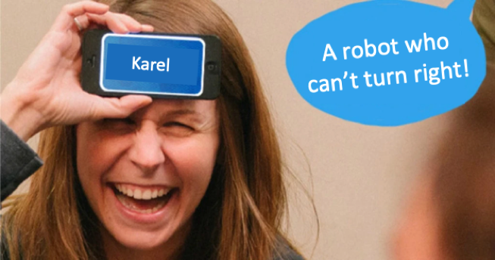
Problem Premise
Heads Up is a game where one person takes the role of a “guesser”. A word will be generated at random, and everyone who isn’t the guesser will provide hints as to what the word is, without saying the actual word. The guessers job is to guess what the word is as fast as possible! An example of a round of this game is shown on the right.

Slide 17

Problem Overview
We are all going to become game developers today, as our job is to recreate the functionality of this game!
We are going to take a list of words from a file and then use that list with our knowledge of Python to recreate a console-based version of this game!

Slide 18
End Goal
Example Input
Example Output
(Example Word List)
Apple
Banana
Pear
Blueberry
Strawberry
Longan
Lychee
Tamarind
Orange
The word to guess: Lychee
Hit ‘enter’ to get the next word.
The word to guess: Pear
Hit ‘enter’ to get the next word.
The word to guess: Longan
Hit ‘enter’ to get the next word.
...

Slide 19
Problem Details
Words
We provide a list of words for you to use in a file named “cswords.txt”.
Files
We are given a function that will read words from a file for us called get_words_from_file(...).
Game Loop
We want to repeat the game infinitely (or until we hit the stop button at the top of the IDE)

Slide 20
Coding Time!

Slide 21
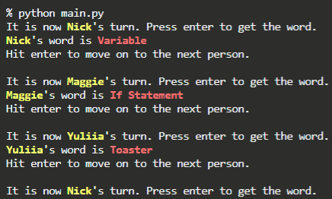
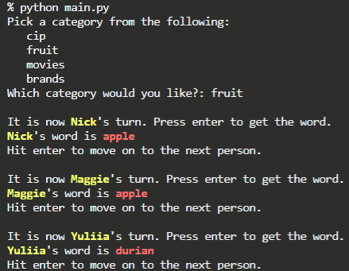
Extensions
Organization:
Cycle through names so people have turns. Great for virtual play!
Categories:
Make your own word lists and add categories to play with! (Bonus points for using a dictionary!)

Slide 22
Thank You
This experience wouldn’t be possible without all you amazing students! It was a joy working with you during this iteration of Code in Place!!!

